Slide 1
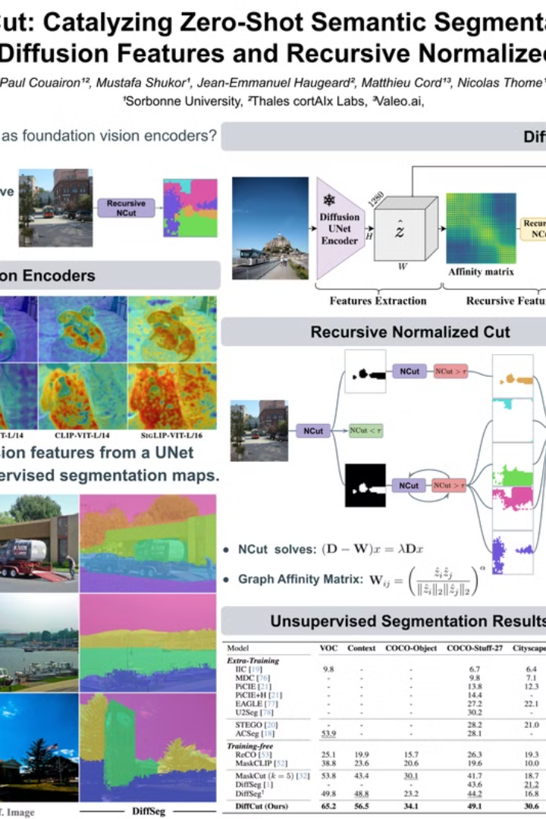
DiffCut: Catalyzing Zero-Shot Semantic Segmentation
DiffCut, a novel approach to zero-shot semantic segmentation. DiffCut leverages features from a diffusion model's UNet encoder and a recursive normalized cut algorithm to segment images without any pre-labeled training data.

Slide 2
Introduction & Motivation
The Need for Unsupervised Segmentation
Leveraging Diffusion Models
The scarcity of labeled data poses a significant hurdle in computer vision. Traditional supervised learning methods demand extensive annotated datasets, which are often expensive and time-consuming to create.
Generative models, particularly diffusion models, have demonstrated the capacity to capture rich semantic features. These models offer an untapped potential for repurposing their learned representations for downstream tasks like segmentation.
The objective is to understand the necessity of unsupervised semantic segmentation and to delve into the possibilities of using diffusion models for segmentation purposes. Exploring the potential of diffusion models can lead to robust and efficient segmentation techniques, addressing the data scarcity issue in computer vision.

Slide 3
Problem Statement
The Core Challenge
Proposed Solution
Terminology
How can we segment images into meaningful parts without depending on manually labeled datasets? This challenge is central to advancing unsupervised learning in computer vision.
Leverage diffusion model features to perform zero-shot segmentation, which allows models to segment images without prior training on specific classes. This approach addresses the core challenge directly.
Zero-Shot Semantic Segmentation: Segmenting images without prior training on those specific classes. It is key to unlocking the full potential of unsupervised methods.
The ability to segment images in a zero-shot manner can revolutionize computer vision tasks, enabling practical applications in scenarios where labeled data is scarce or unavailable. This capability is essential for creating adaptable and efficient segmentation algorithms.

Slide 4
Background: Diffusion Models & UNet Encoder
Diffusion Models
UNet Encoder
Feature Extraction
Diffusion models gradually transform noise into an image, making them suitable for learning detailed feature representations useful for various tasks, including segmentation.
The UNet architecture captures key features by downsampling the image, serving as the "feature extractor" for segmentation, particularly the final self-attention block of the encoder.
By utilizing the UNet encoder, we extract feature maps that inherently contain semantic information, eliminating the need for labeled datasets. This makes zero-shot segmentation feasible and efficient.
Understanding the underlying mechanisms of diffusion models and UNet encoders is crucial for appreciating the innovation of DiffCut. These models offer a unique perspective on feature learning and extraction, enabling advanced segmentation capabilities.

Slide 5


Core Concept: Recursive Normalized Cut
What is it?
How it Works
An algorithm designed to divide an image into segments based on similarity, allowing for precise and coherent segmentation without relying on external labels.
It recursively partitions the image to form coherent segments. This iterative approach ensures that each segment is as homogeneous as possible, enhancing the overall segmentation quality.
The Recursive Normalized Cut algorithm is central to achieving high-quality segmentation results in DiffCut. Its recursive and similarity-based approach enables precise segmentation, even in the absence of labeled data, making it a key innovation in the field.

Slide 6

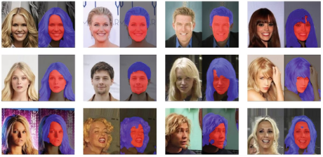



The DiffCut Approach
Diffusion Features
Utilize the final self-attention block of the UNet encoder to extract semantic details, capturing essential features for effective segmentation.
Recursive Normalized Cut
Apply the algorithm to segment the image based on the extracted features, creating accurate and meaningful segmentation maps.
Performance Evaluation
Evaluate the performance without needing labeled data, demonstrating the zero-shot capabilities of the DiffCut approach and its practical applicability.
The DiffCut approach combines the semantic richness of diffusion features with the precision of recursive normalized cut to achieve state-of-the-art zero-shot segmentation. The modularity and efficiency of this method make it a promising avenue for future research and applications in unsupervised learning.

Slide 7
Experimental Setup & Results
Metric
DiffCut
Baseline 1
Baseline 2
Mean IoU
65.2
58.7
60.1
Boundary F1
72.5
68.9
70.3
DiffCut is rigorously evaluated using standard datasets like PASCAL VOC and COCO under zero-shot protocols. Results show state-of-the-art performance in unsupervised segmentation. Both metrics and visual examples highlight its accuracy and ability to segment objects without any labeled training data.

Slide 8




Key Contributions & Impact
Innovative Use of Diffusion Features
Recursive Normalized Cut Integration
Demonstrates the semantic richness of diffusion models for segmentation, revealing new potential in unsupervised feature learning.
Provides a novel method to partition images without labeled data, enabling precise segmentation without reliance on manual annotations.
State-of-the-Art Results
Achieves high performance in zero-shot segmentation tasks, outperforming existing methods and setting a new benchmark in the field.
The work not only advances the state of the art but also opens new avenues for unsupervised learning in computer vision. The contributions significantly reduce the dependence on labeled data, offering practical solutions for real-world applications where annotations are scarce or unavailable.

Slide 9
Discussion & Future Work
Strengths
Limitations
Efficiency
Challenges with complex scenes
Reproducibility
Computational demands
Future work includes extending the approach to other domains, such as video segmentation, and improving scalability to handle more complex images. Exploring alternative feature extraction techniques and refining the recursive normalized cut algorithm could further enhance the model's performance and versatility.

Slide 10
Conclusion & Resources
In conclusion, DiffCut signifies a leap forward in zero-shot semantic segmentation by leveraging the power of diffusion features and a recursive normalized cut algorithm. Its novel contributions open new opportunities for unsupervised learning in computer vision, reducing the reliance on labeled data and enabling more adaptable and efficient segmentation techniques.
For further exploration, refer to the links below:
Paper Link
GitHub Repository
Poster/Video
Thank you for your attention. Are there any questions?

